Slide 1
Credit Card Fraud Detection
Serena Du

Slide 2

Overview
Credit Card Transaction Data + User Demographic + Card information
Data Size: 6,877,837 rows with 46 columns
Predictive Modeling: Fraud Classification

Slide 3
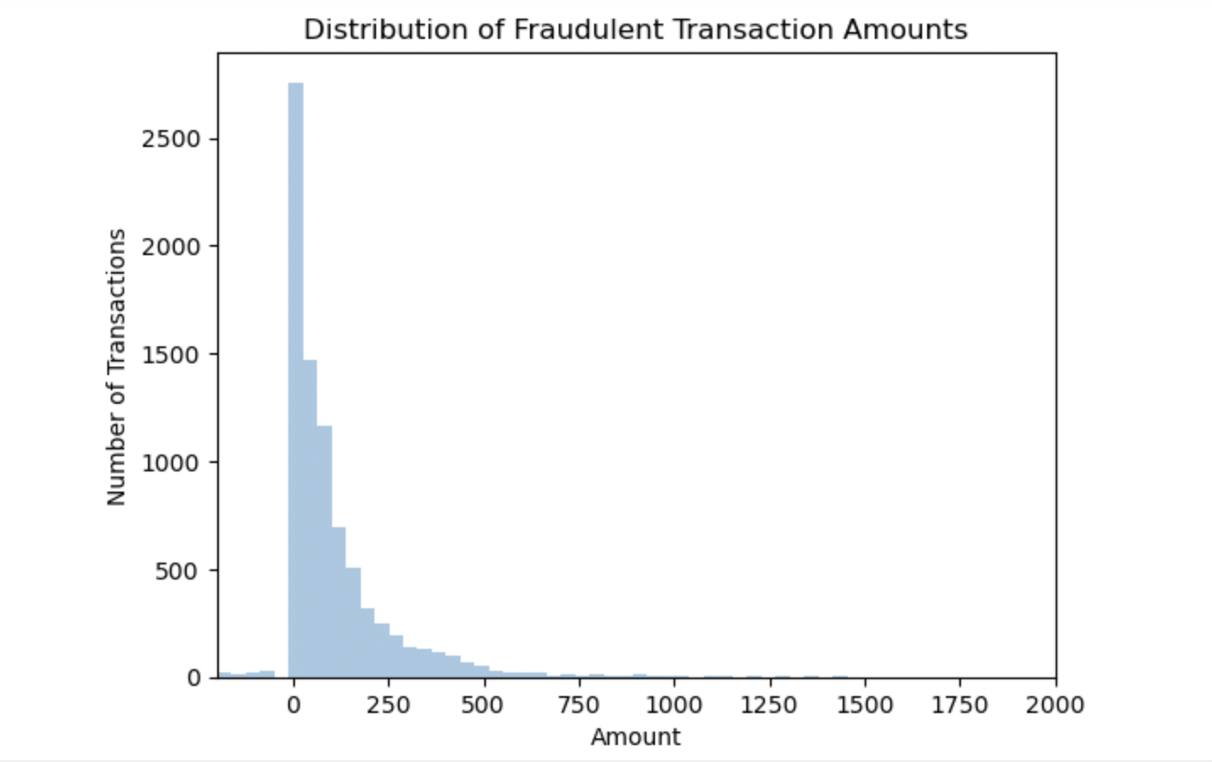
EDA

Slide 4
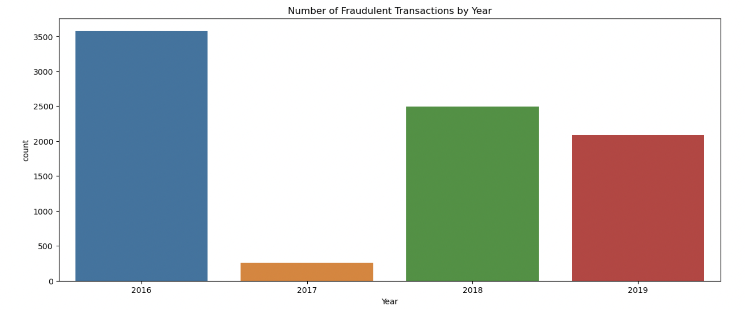
EDA

Slide 5
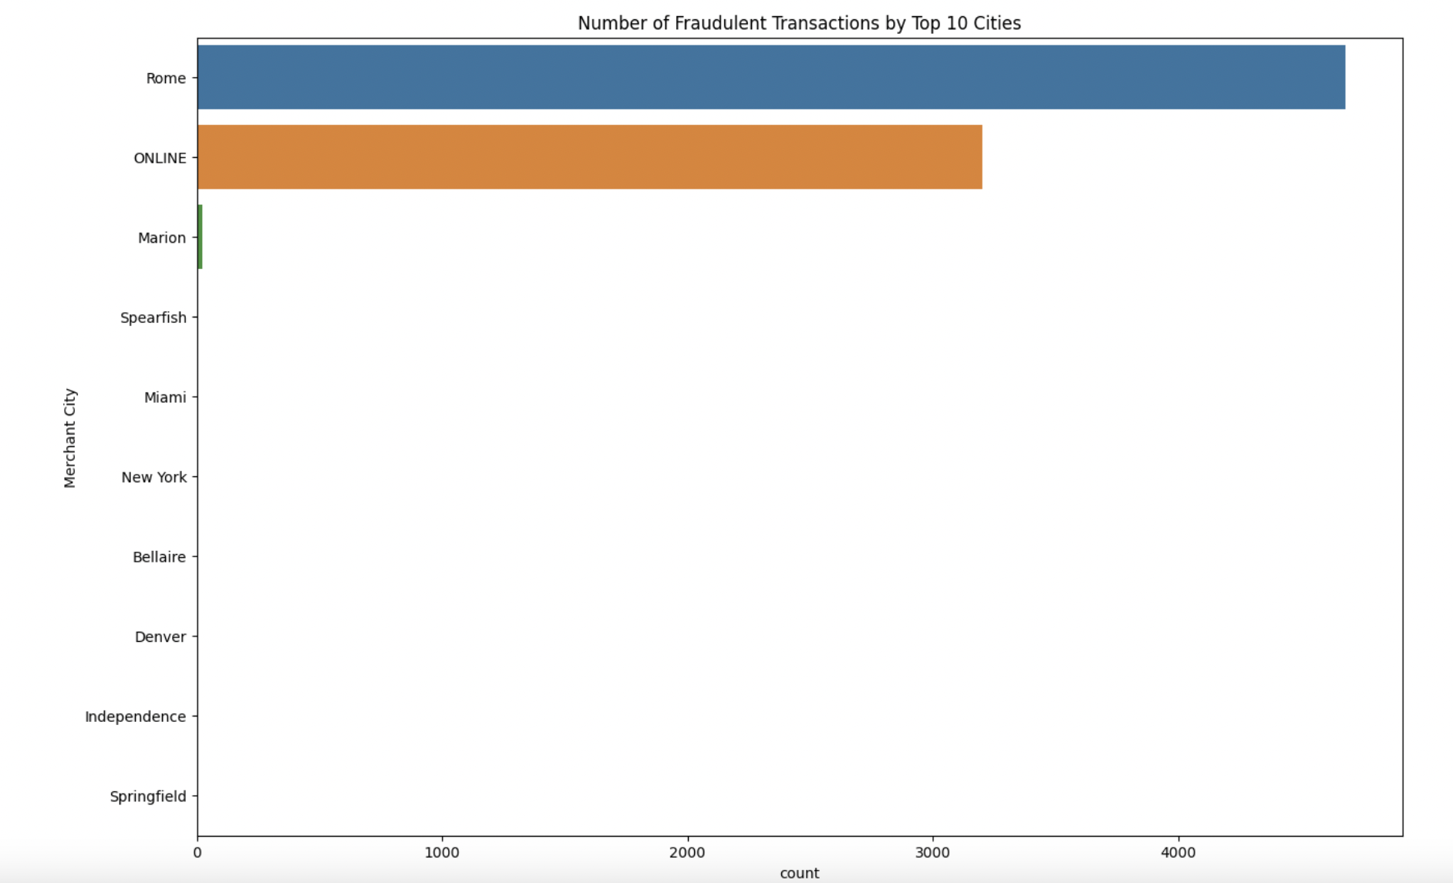
EDA

Slide 6
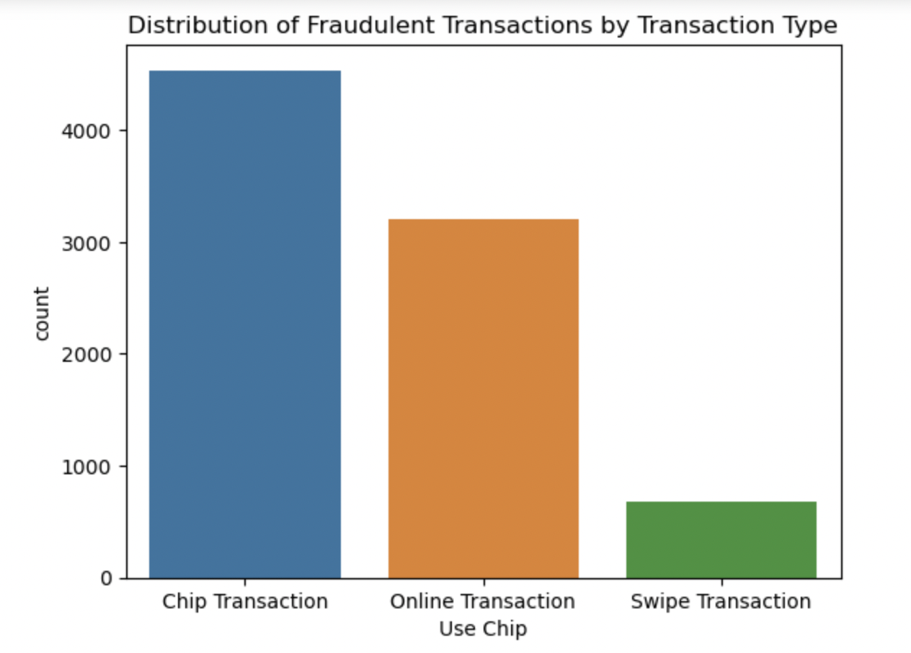
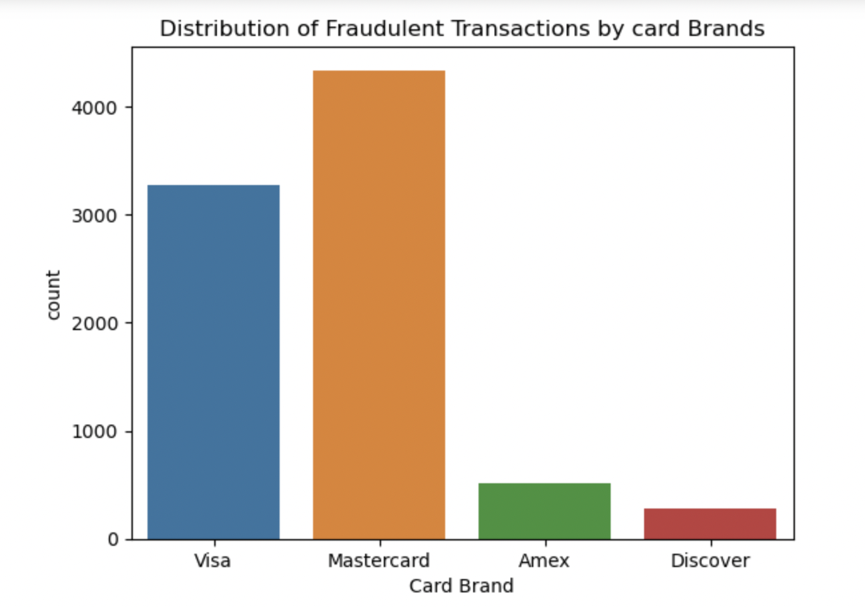
EDA

Slide 7
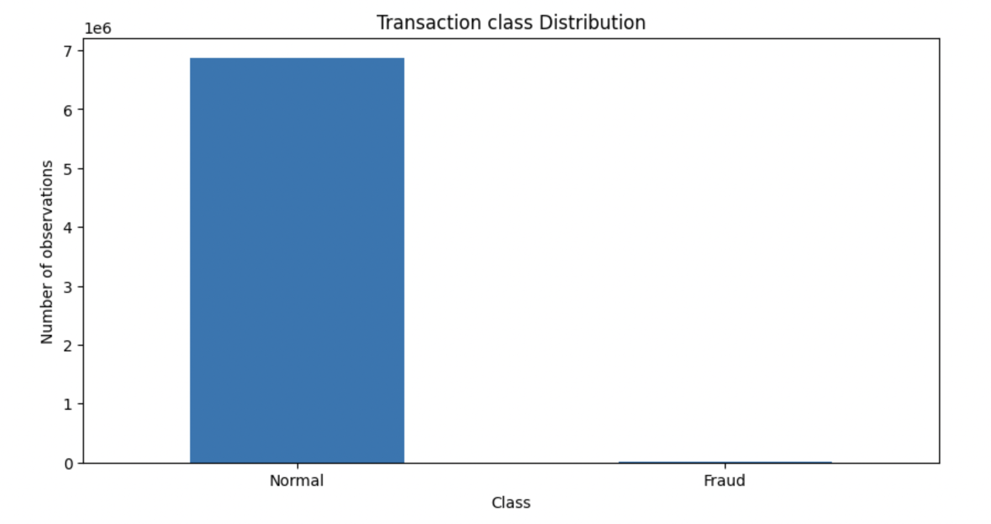
Data Cleaning
Change data types e.g.: Amount, Per Capital Income etc.
Create new columns e.g.: breakdown date to year, month, day; add current age based on pre-defined retirement age etc.
Under-sampling: 50/50 split for fraud and normal data
Feature pre-selection to get rid of some variables e.g.: Merchant name, apartment, address etc.
Fill missing values as 0
Scale data to balance impact of all variables
Dummy Coding for categorial variables

Slide 8
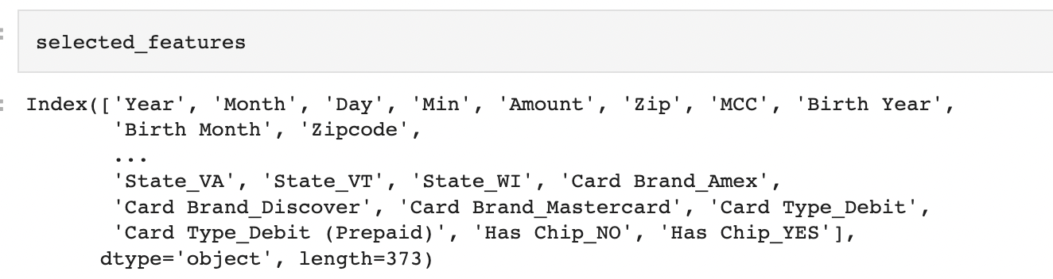
Feature Selection
Elastic Net – Combine advantages of Lasso and Ridge

Slide 9
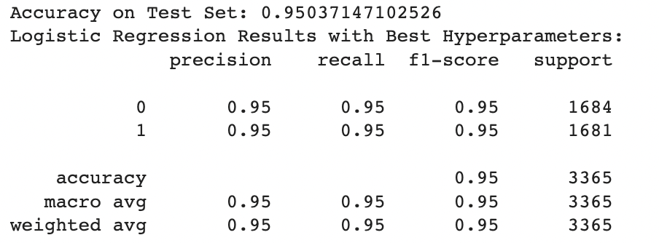
Classification Model 1
Logistic Regression

Slide 10
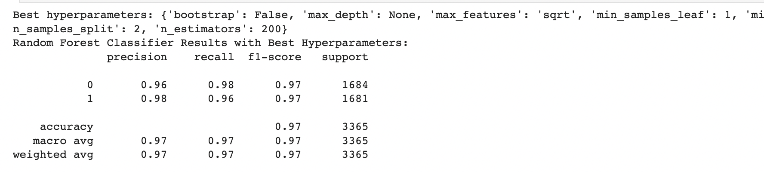
Classification Model 2
Random Forest

Slide 11
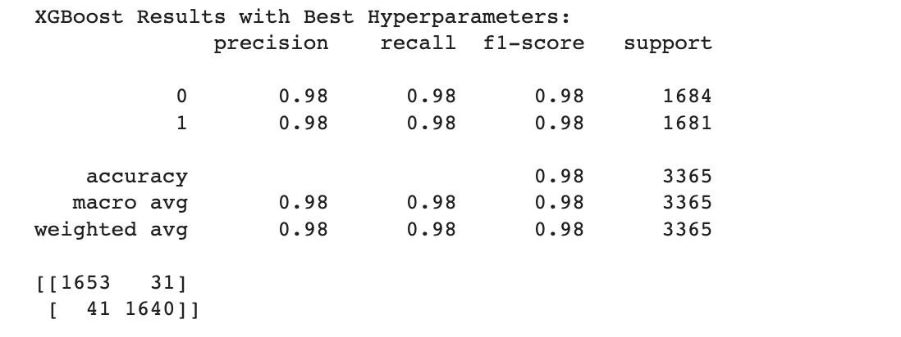
Classification Model 3
XGBoost

Slide 12
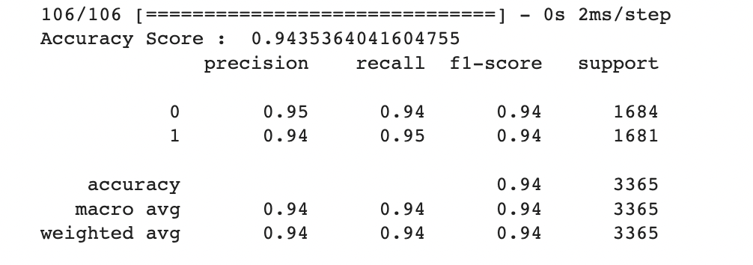
Classification Model 4
Artificial Neural Network

Slide 13

XGBoost
Winner

Slide 14
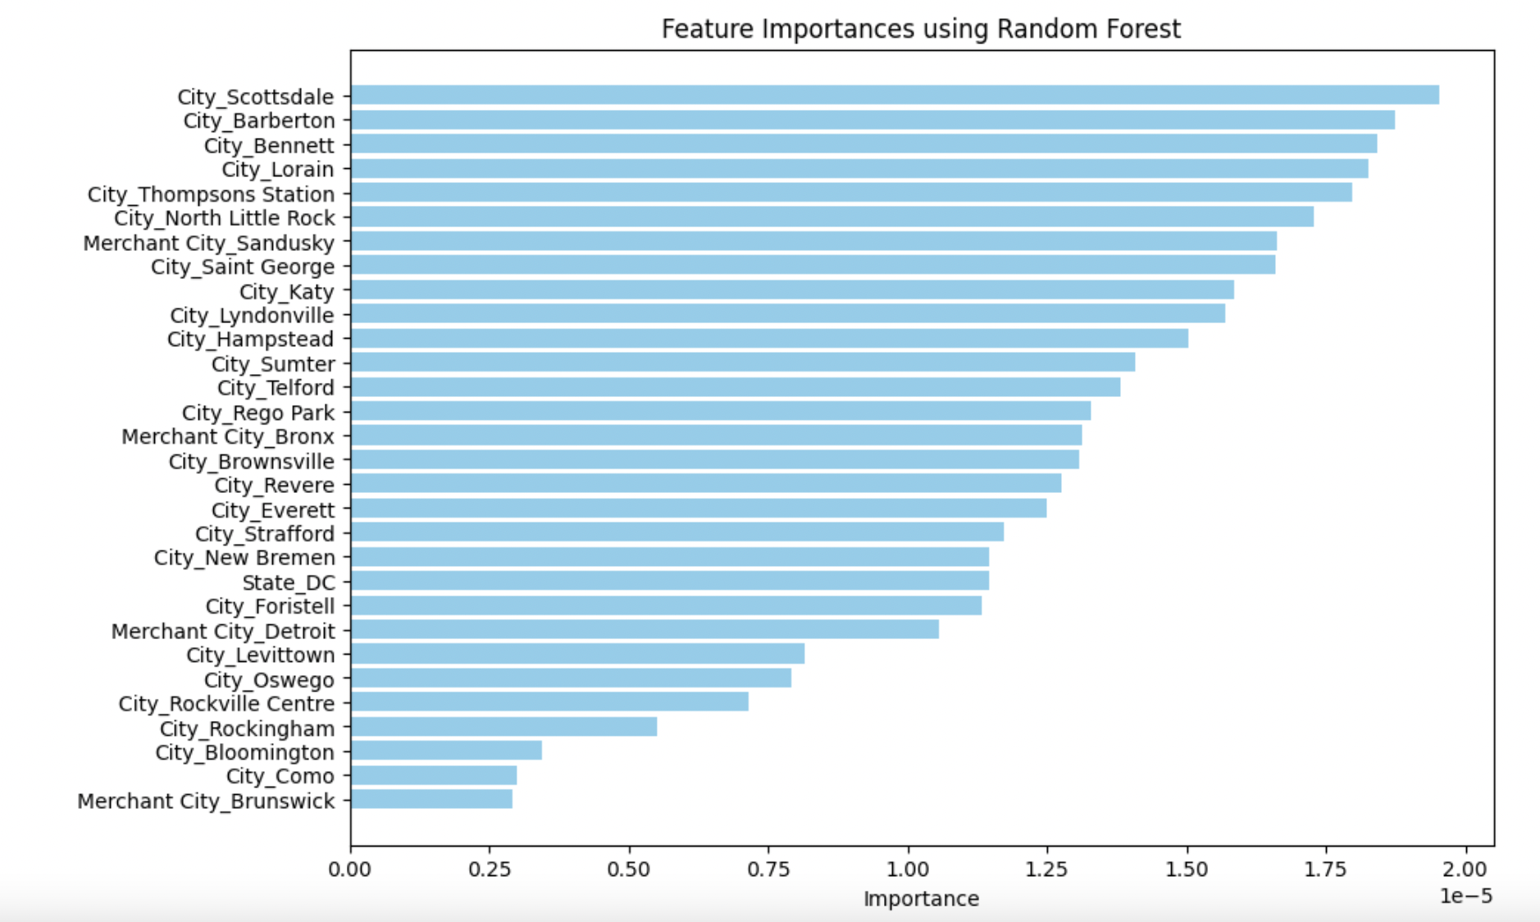
Insights
Location influences fraudulent activities the most

Slide 15

Conclusion
Data Cleaning and pre-processing is the most difficult part
Couldn’t further implement parameter tuning for ANN due to memory issue

Slide 16

Thank YOu

